Slide 1
CS 252 Database Management Systems
Jan – May 2020
IV Semester
* Use the slides for reference only. Refer the text book for details

Slide 2
Data model, Schema and Instance
A data model is a collection of concepts that can be used to describe the structure of a database. It provides details about the data types, relationships and constraints that apply to the data
Conceptual data model – represents concepts as perceived by users
Physical data model – represents concepts as stored physically in a database
The description of a database is called the database schema, which is specified during database design and is not expected to change frequently.
The actual data in a database may change quite frequently. The data in the database at a particular moment in time is called a database state or snap shot. It is also called the current set of occurrences or instances in the database.

Slide 3
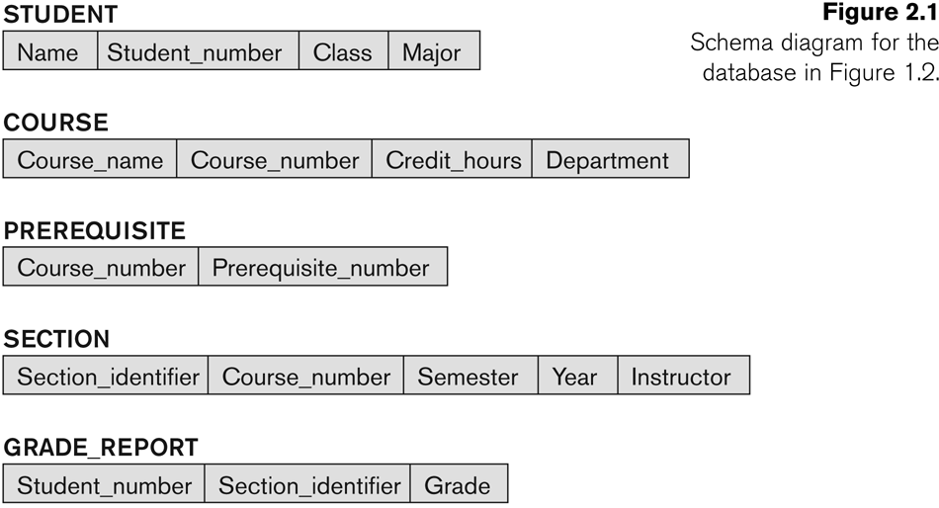
Example of a Database Schema

Slide 4

Example of a database instance

Slide 5
Three schema architecture
Goal is to separate the user applications from the physical database.
In this architecture, schemas can be defined at the following three levels:
Internal level
- Describes the physical storage structure of the database.
Conceptual level
- The conceptual schema hides the details of physical storage structures and concentrates on describing entities, data types, relationships, user operations and constraints
External level
- Each external schema describes the part of the database that a particular user group is interested in and hides the rest of the database from that user group

Slide 6
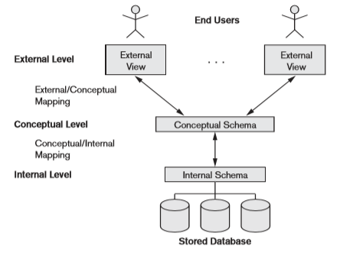
Three schema architecture

Slide 7
Data abstraction
Data abstraction generally refers to the suppression of details of data organization and storage and highlighting of the essential features for an improved understanding of data
One fundamental characteristic of any database management system is that it provides some level of data abstraction so that different users can perceive data at their preferred level of detail.

Slide 8
Data Independence
Data independence can be defined as the ability to change the schema at one level of a database system without having to change the schema at the next higher level.
Logical data independence is the capacity to change the conceptual schema without having to change external schemas or application programs
Physical data independence is the capacity to change the internal schema without having to change the conceptual schema. Hence, the external schemas need not be changed as well

Slide 9
Database Languages
Data definition language (DDL), is used by the Database administrators and by database designers to define conceptual and internal schemas. The DBMS will have a DDL compiler whose function is to process DDL statements in order to identify descriptions of the schema constructs and to store the schema description in the DBMS catalog.
In DBMSs where a clear separation is maintained between the conceptual and internal schemas, DDL is used to specify the conceptual schema only. Storage definition language (SDL) is used to specify the internal schema

Slide 10
Database Languages
View definition language (VDL) is used to specify user views and their mappings to the conceptual schema. In relational DBMSs, SQL is used to define user or application views as results of predefined queries.
Data manipulation language (DML) provides users ability to manipulate the data in a database. Typical manipulations include retrieval, insertion, deletion and modification of the data.
A high-level or nonprocedural DML
A low-level or procedural DML

Slide 11
Database Interfaces
Menu-Based Interfaces for Web Clients or Browsing.
These interfaces present the user with lists of options (called menus) that lead the user through the formulation of a request. Menus do away with the need to memorize the specific commands and syntax of a query language
Forms-Based Interfaces
- A forms-based interface displays a form to each user. Users can fill out all of the form entries to insert new data, or they can fill out only certain entries in which case the DBMS will retrieve matching data for the remaining entries. Forms are usually designed and programmed for naive users as interfaces to canned transactions

Slide 12
Database Interfaces
Graphical User Interfaces
A GUI typically displays a schema to the user in diagrammatic form. The user then can specify a query by manipulating the diagram
Natural Language Interfaces.
- These interfaces accept requests written in English or some other language and attempt to understand them. A natural language interface usually has its own schema,which is similar to the database conceptual schema, as well as a dictionary of important words. The natural language interface refers to the words in its schema, as well as to the set of standard words in its dictionary, to interpret the request. If the interpretation is successful, the interface generates a high-level query corresponding to the natural language request and submits it to the DBMS for processing

Slide 13
Database Interfaces
Speech Input and Output.
Limited use of speech as an input query and speech as an answer to a question or result of a request is becoming commonplace.
Applications with limited vocabularies such as inquiries for telephone directory, flight arrival/departure, and credit card account information are allowing speech for input and output to enable customers to access this information. The speech input is detected using a library of predefined words and used to set up the parameters that are supplied to the queries.
Interfaces for Parametric Users.
- Parametric users, such as bank tellers, often have a small set of operations that they must perform repeatedly. Usually a small set of abbreviated commands is included, with the goal of minimizing the number of keystrokes required for each request.

Slide 14
Database Interfaces
Application Programming Interfaces
- Applications interact with most of the databases using the API calls to the database. These APIs are defined in a manner to pass out the requested data in a predefined format that is understandable by the requesting client.

